Slide 1
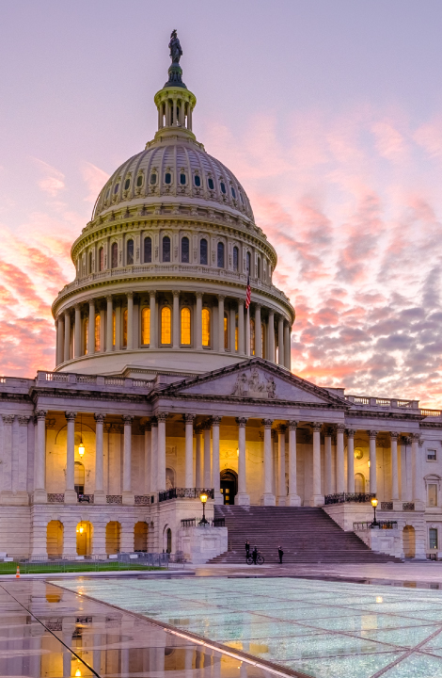
Transforming Government Forms
Fueling Federal Innovation with ServiceNow Creator Workflows
Creator Workflows Federal
March 7th , 2024
Notes:
Welcome everyone. Today, we’ll be diving into the world of government forms.
This topic that can be a bit dry so I’d like to start with a bit of humor with you all.
<NEXT>

Slide 2
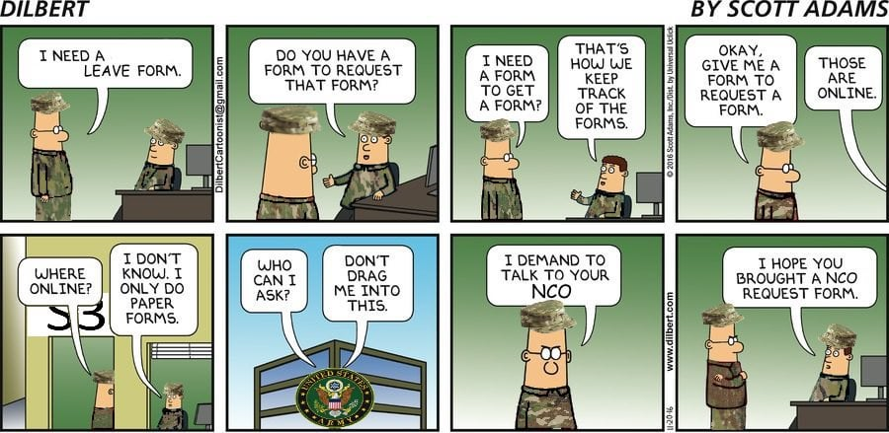
DILBERT
Notes:
CLICK TO REVEAL PANELS

Slide 3



ServiceNow Speakers
Joe Kim
Creator Workflows Solution Executive
Marc Mouriès
Creator Workflows
Senior Advisory
Solution Consultant
Dale Stubblefield
Creator Workflows
Senior Advisory
Solution Consultant
Notes:
Hello everyone, I am Marc Mouries and I'm joined by Joe & Dale. We are from the Creator Workflows team at ServiceNow.
Together, we bring a wealth of experience modernizing forms and applications with ServiceNow’s App Engine.
We specialize in turning the form maze into a straight line with ServiceNow's App Engine.

Slide 4
Safe harbor notice for forward-looking statements
Notes:
Before we dive into the content, as a reminder, I want to point out this session may contain 'forward-looking' statements,
In brief it says that plans and features can change, so don’t use them for making purchasing decisions.
Always reach out to your ServiceNow team for the most up-to-date information.
And don't worry, no pirates were harmed in the making of this safe harbor notice.

Slide 5
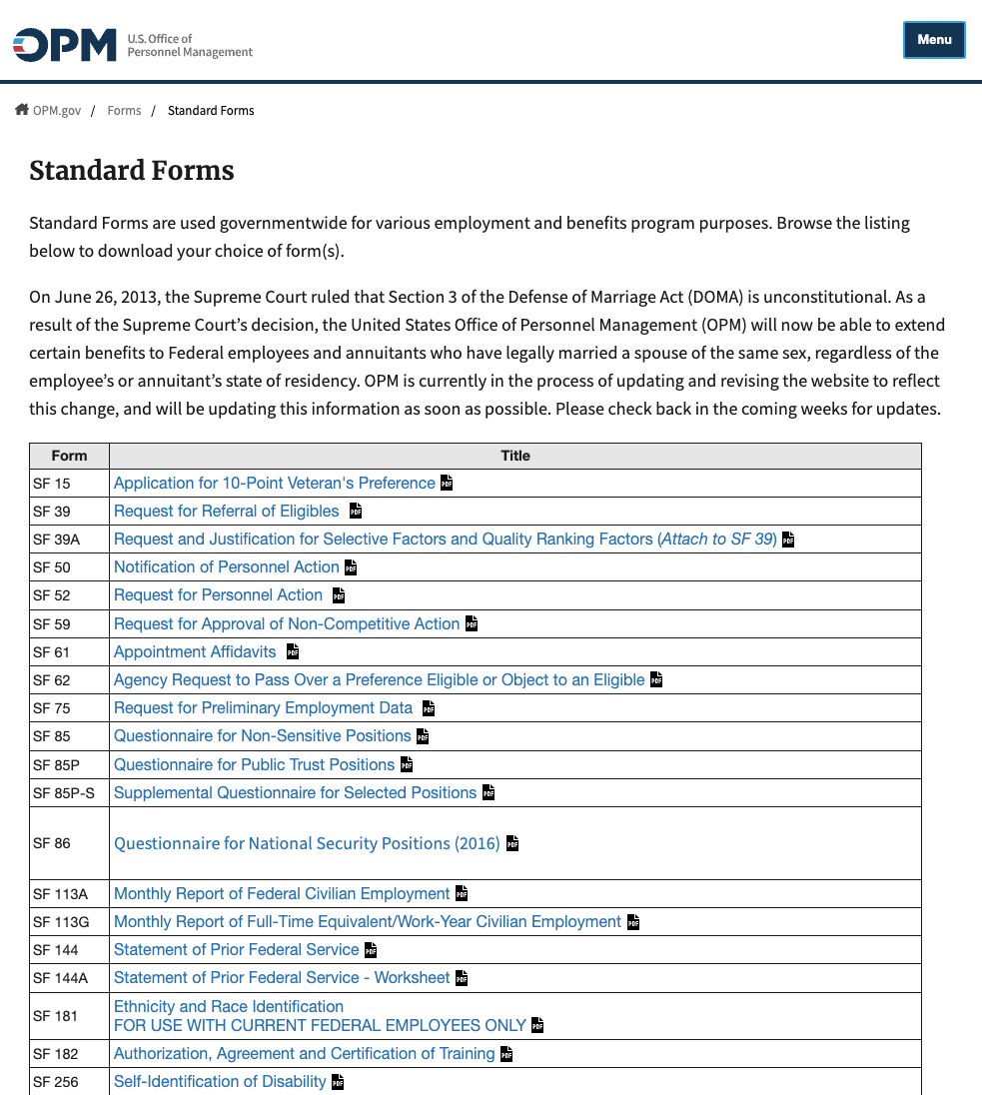
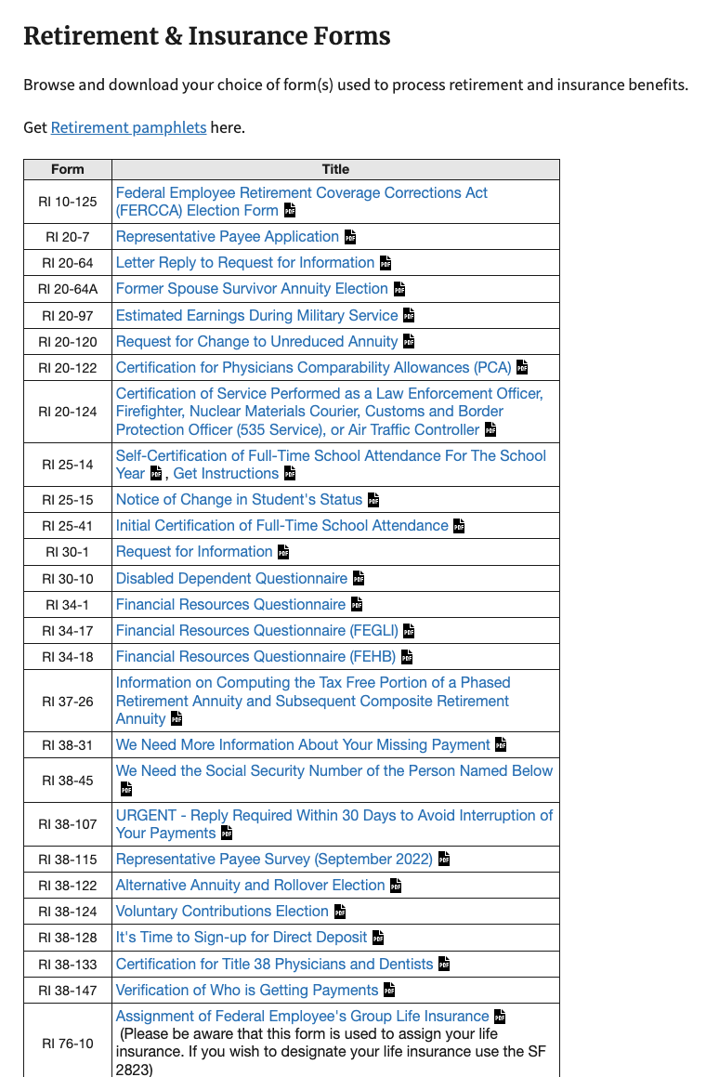
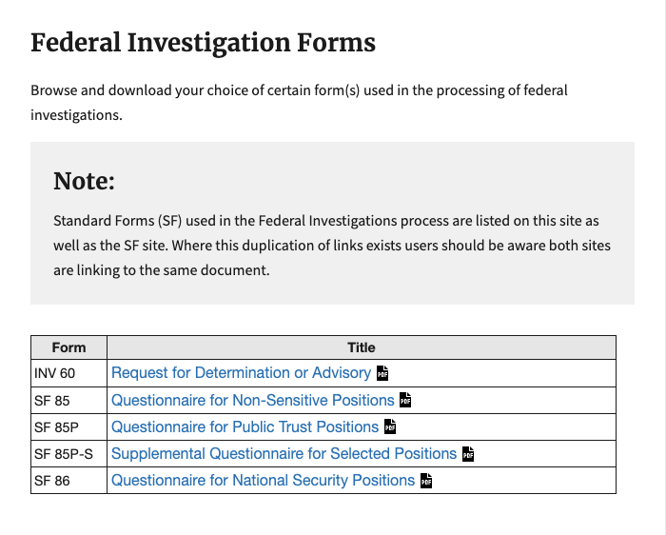
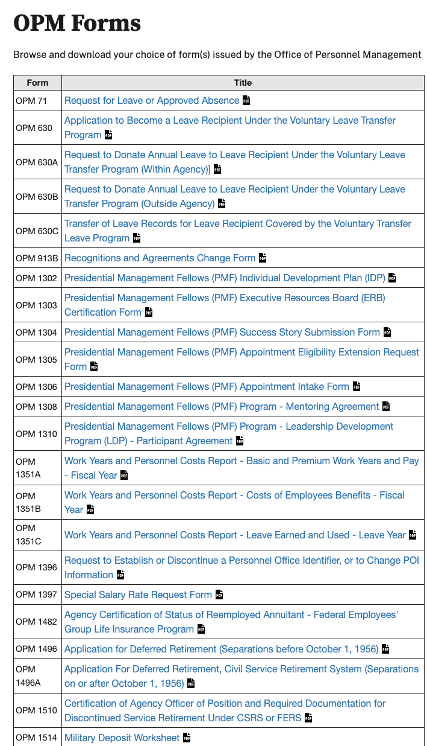
Forms of Government Forms: A Love Story
+ 100’s of agency specific forms
60
Standard
Forms
57
OPM
Forms
30
Retirement & Insurance Forms
5
Investigation Forms
Notes:
To get started, do we have forms? Yes we do!
NEXT. Show a long list of forms agencies have to deal with.

Slide 6
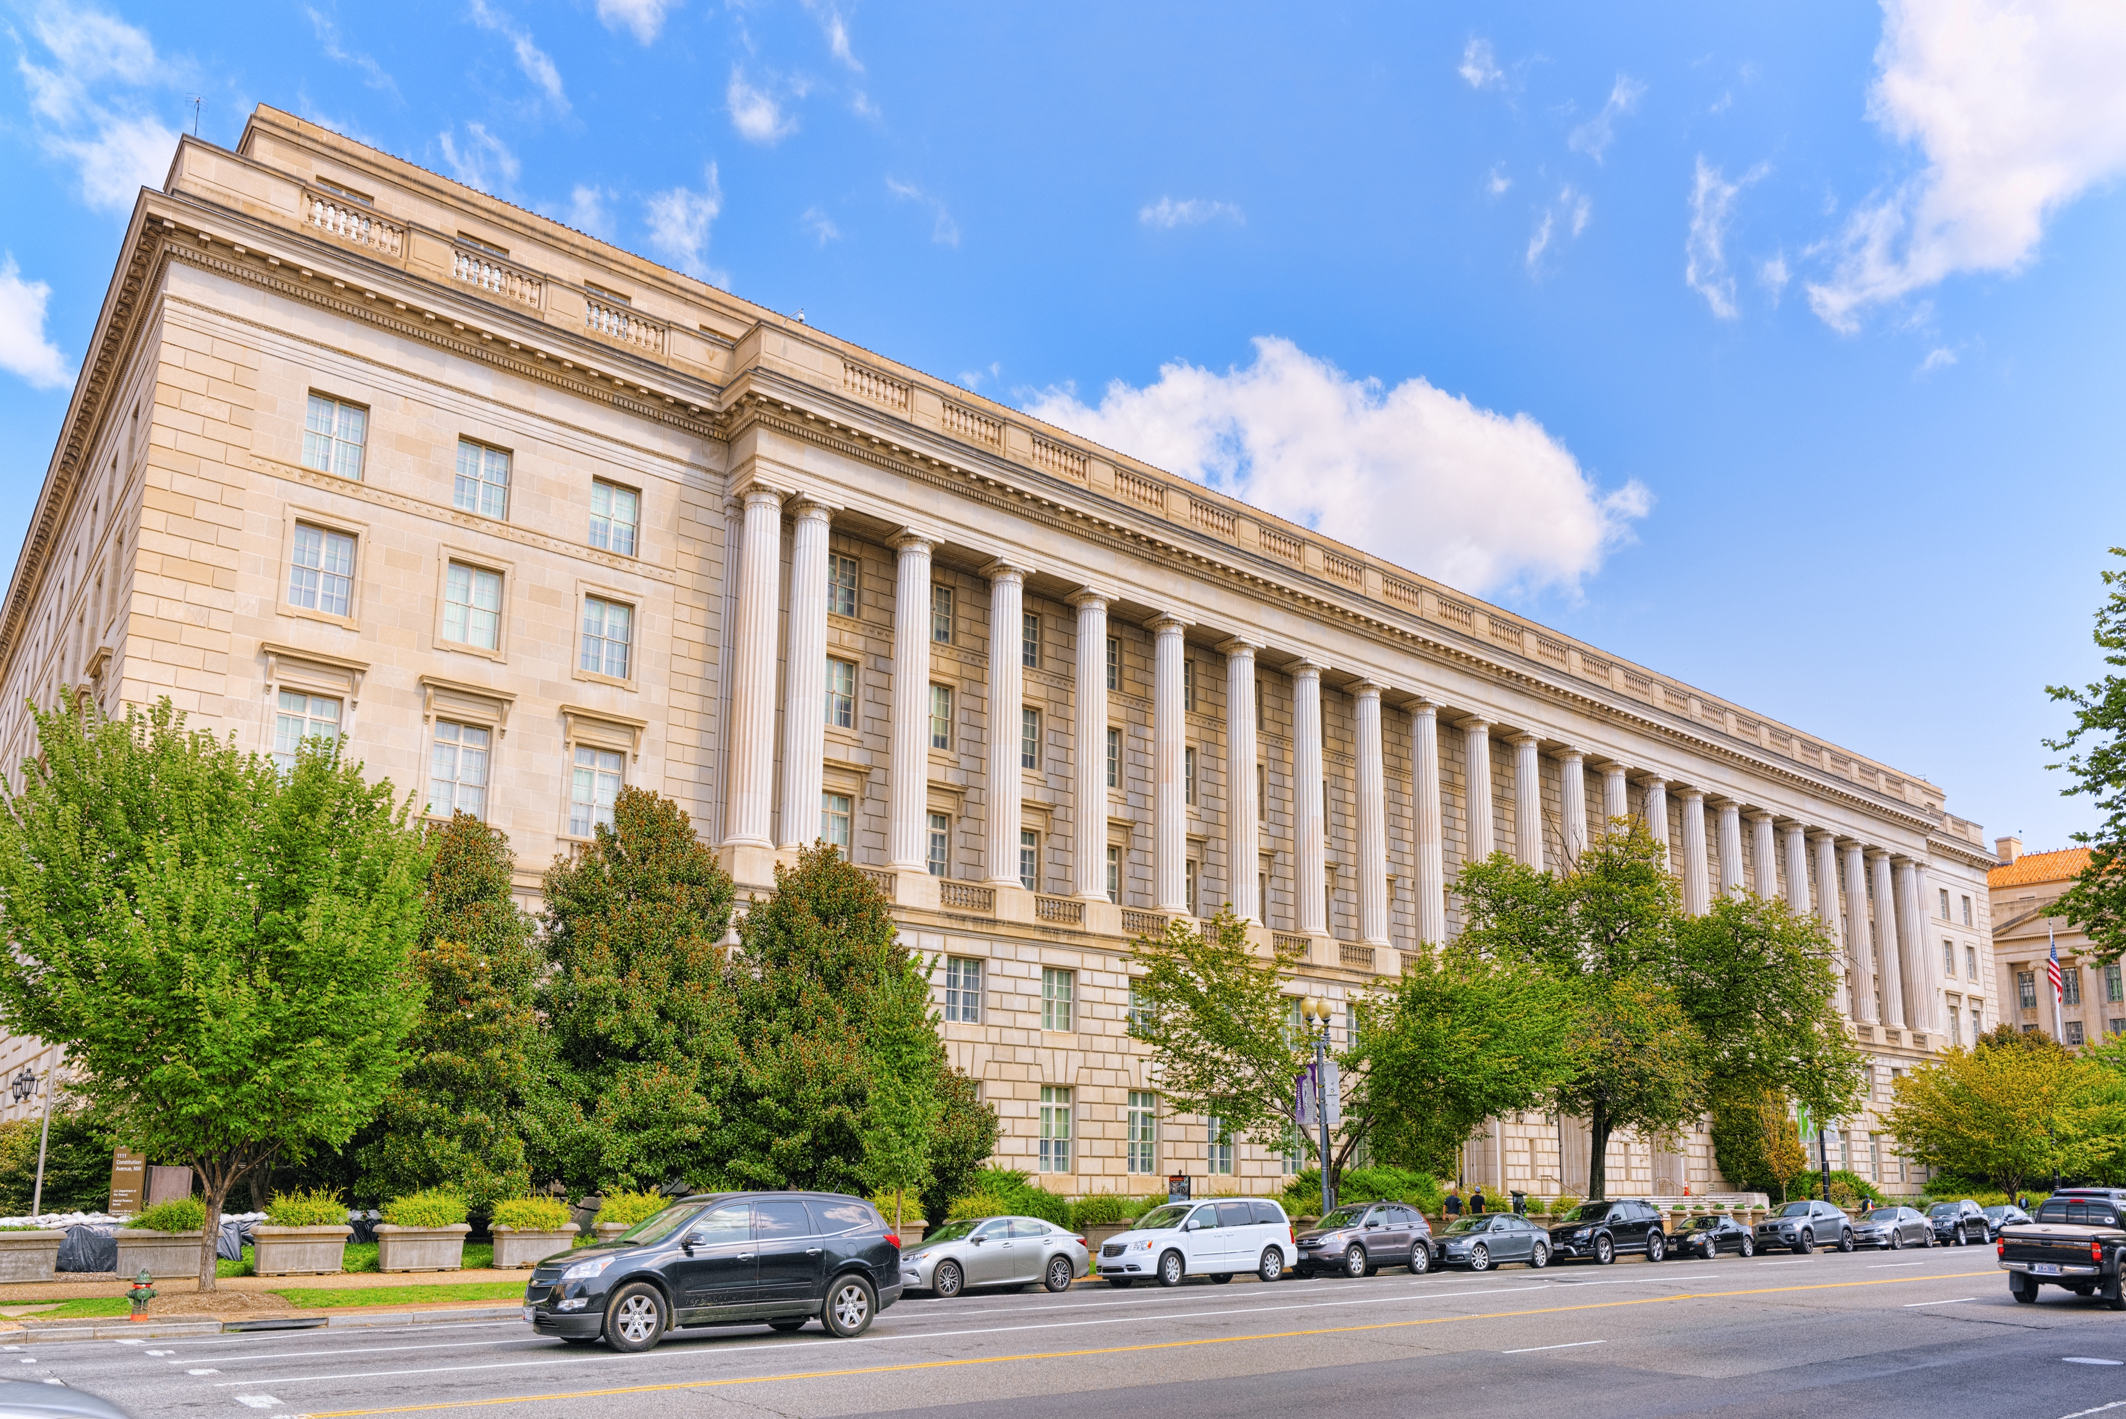


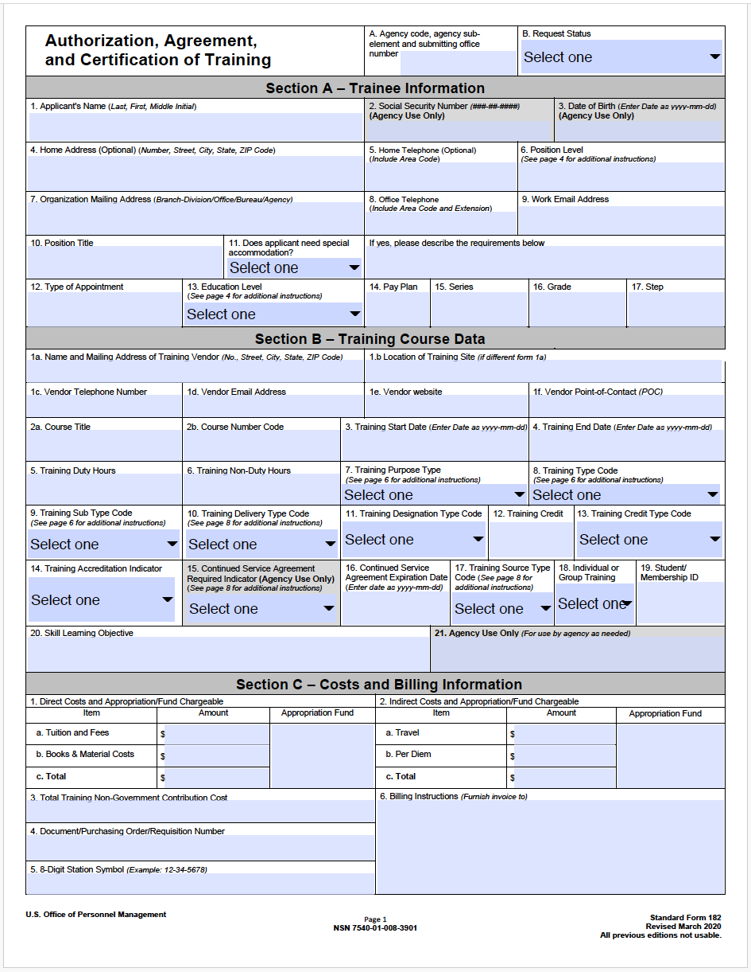
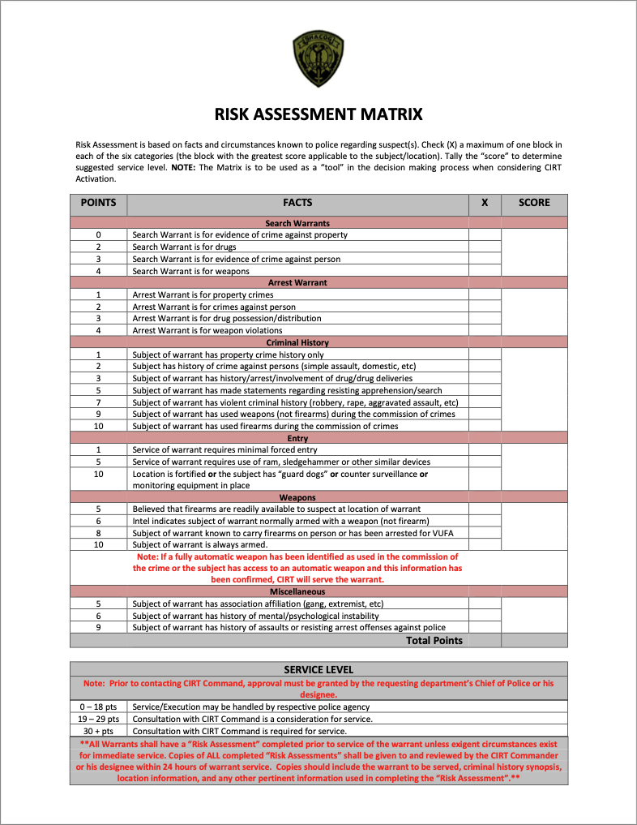
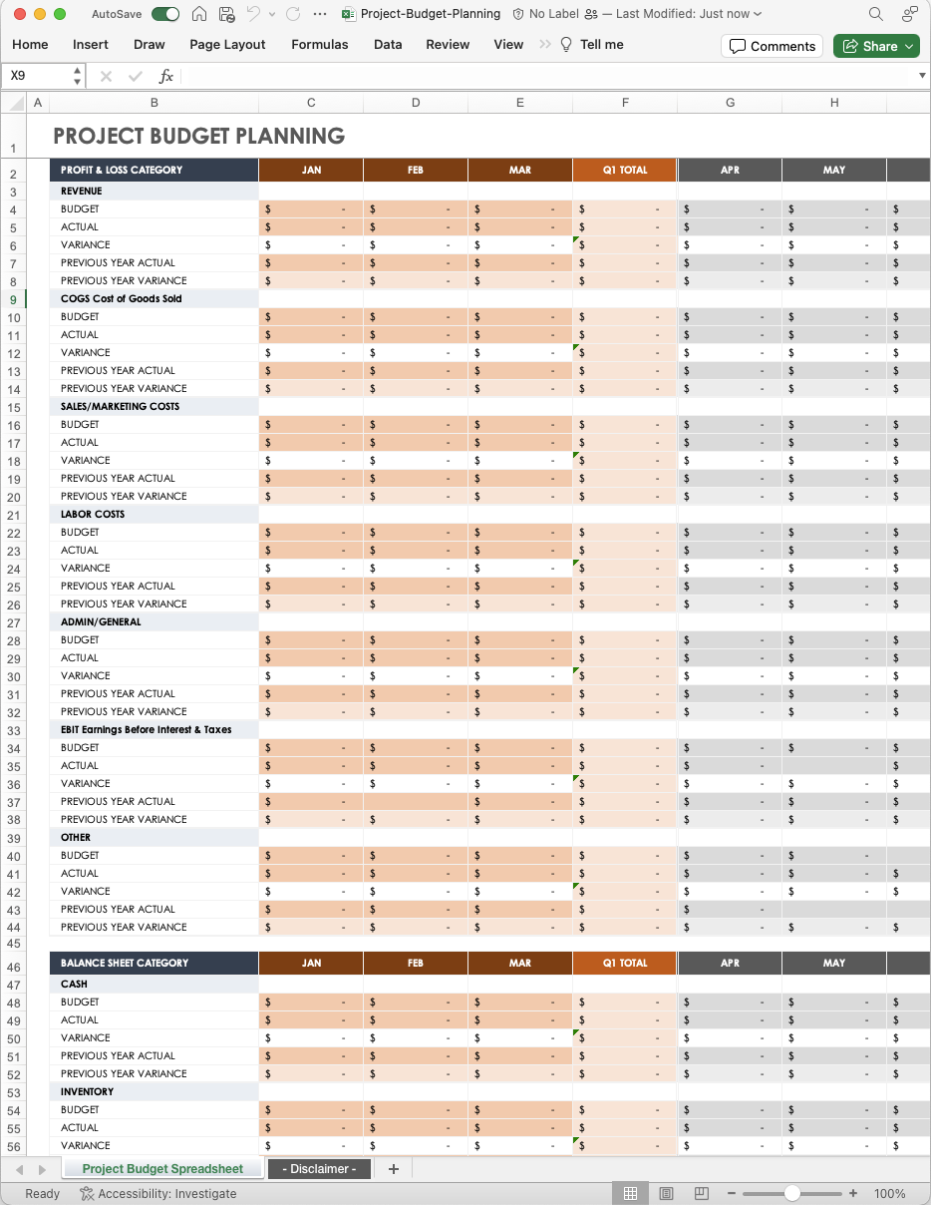
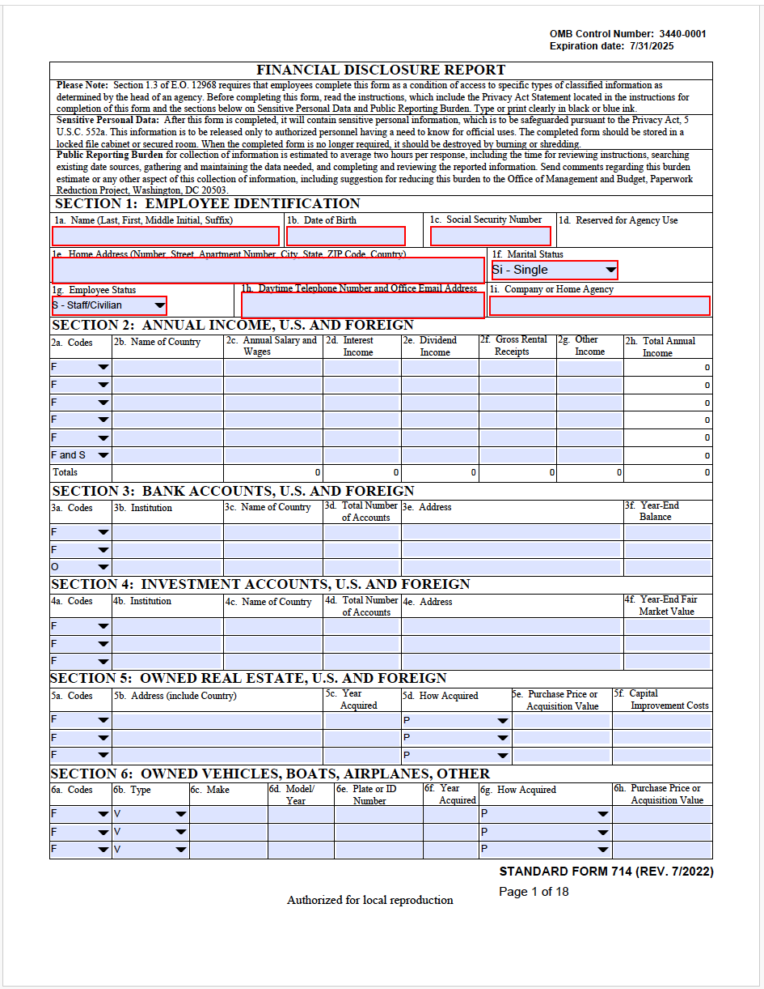
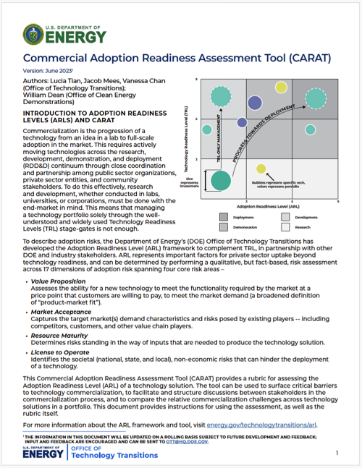
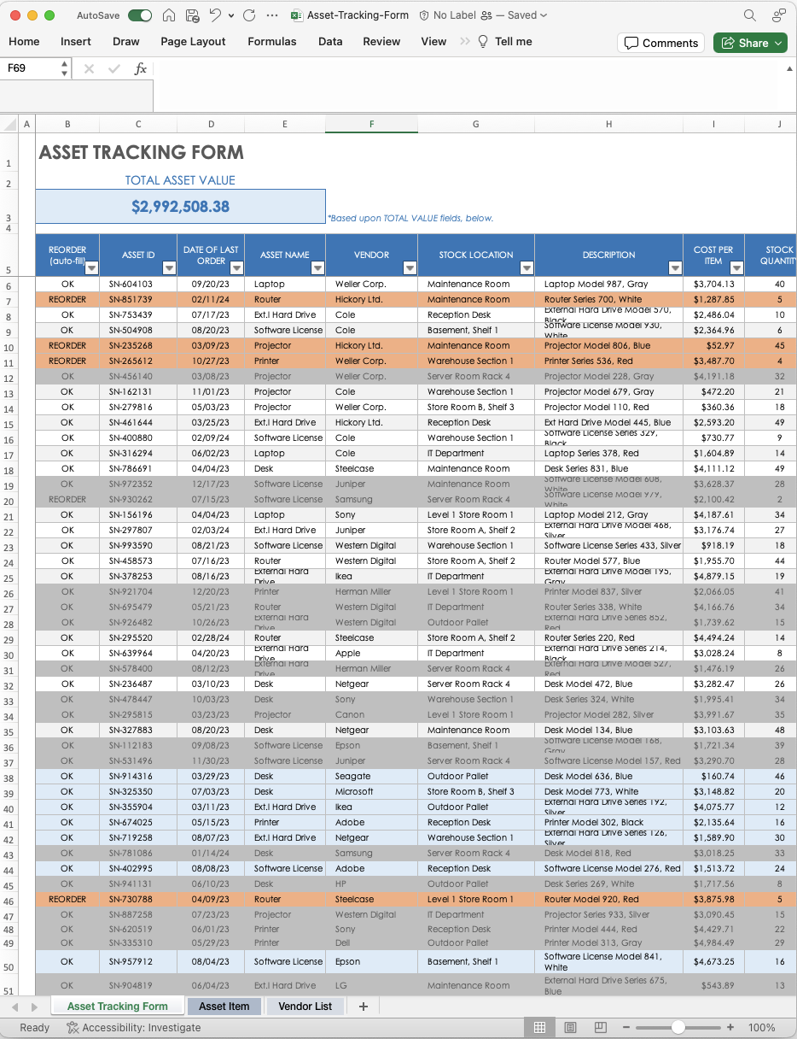
Forms have all shapes, sizes and purposes
Request forms
Data & Tools forms
Spreadsheets
Notes:
When we talk about 'forms,’ this includes a range of formats, from:
the traditional paper-based documents to
PDFs,
outdated web forms, and even surveys. When we talk about 'forms,’ this includes a range of formats
And types. Forms can be a request form like the leave request form,
They can be a data capture form like a ship log or an operation planning form, and there are PDFs that are not really a form like CARAT,
the traditional paper-based documents to,
outdated web forms, and even surveys.

Slide 7
Quiz time! Most Used Forms
What are the top 3 forms you frequently use?
_____________
_____________
_____________
Example Forms we frequently hear about:
SF-182 (Training request)
SF-74 (Financial disclosure)
DD Form 2875, System Authorization Access Request
DA Form 638 recommendation for award
Notes:
We’d love to hear what forms you use the most.
Take a moment to answer our poll:
What are the top 3 forms you frequently use?
While you do that, remember you can ask questions anytime during this webinar through the Q&A panel at the bottom left of your screen
Pause 10 seconds.
Show the answers.
Thank you for participating in our poll, we truly appreciate the feedback!
forms our customers frequently talk about:
SF-182 for training request,
SF-74 for financial disclosure,
DD Form 2875, System Authorization Access Request,
DA Form 638 recommendation for award.
OTHE FORMS?

Slide 8
Quiz time! Longest time to complete and process
Which form(s) in your agency are the most time-consuming to complete and process?
_____________
_____________
_____________
Notes:
We’d love to hear what forms you use the most.
Take a moment to answer our poll:
What are the top 3 forms you frequently use?
While you do that, remember you can ask questions anytime during this webinar through the Q&A panel at the bottom left of your screen
Pause 10 seconds.
Show the answers.
Let’s go back to the 13 steps we were looking at CLICK (go to next slide)
Thank you for participating in our poll, we truly appreciate the feedback!
forms our customers frequently talk about:
SF-182 for training request,
SF-74 for financial disclosure,
DD Form 2875, System Authorization Access Request,
DA Form 638 recommendation for award.
OTHE FORMS?

Slide 9
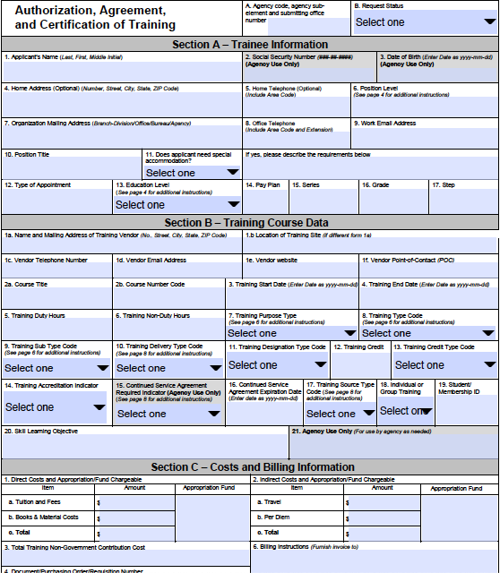
SF-182: Authorization, Agreement, and Certification of Training
Notes:
Let’s take a look at the form: SF-182: Authorization, Agreement, and Certification of Training
Remember the Dilbert story?
And if you think this never happens or it’s less worse than that, let us walk you through the stories we hear from our customers.

Slide 10





SF-182: Current state
Employee
Obtains the
SF-182 form
Fills the Employee Information in the Form
Fills the Training & Cost Info in the Form
Email the Form to manager
Employees must obtain a copy of the OPM Form SF-182.
Validates & approves
Second-line
Supervisor
Email the Form to 2nd line manager
Validates & approves
First-line
Supervisor
Email the Form to Training Officer
Training
Officer
Validates & approves
Email the Form to Authorizing Official
Authorizing
Official
Supervisor puts the name of the authorizing official?
Cost & Training info is manually entered in Cornerstone
Manually request Purchase in ServiceNow
Email approval notice to employee
Validates & approves
Notes:
COPY OF SLIDE WITH NO ANIMATIONS.
USE ONLY IF NEEDED.

Slide 11
SF-182: Current state
Highly Manual
Time-consuming, prone-to-error tasks
Time consuming
Form is not intuitive to fill (ex: see page 6 for instructions)
What form?
Not using the latest version
Employee
Obtains the
SF-182 form
Fills the Employee Information in the Form
Fills the Training & Cost Info in the Form
Email the Form to manager
Employees must obtain a copy of the OPM Form SF-182.
Validates & approves
Second-line
Supervisor
Email the Form to 2nd line manager
Validates & approves
First-line
Supervisor
Manual Work
Opening PDF and Emailing
Lack of Visibility
Where should I check status?
Email the Form to Training Officer
Training
Officer
Validates & approves
Email the Form to Authorizing Official
Authorizing
Official
Supervisor puts the name of the authorizing official?
Cost & Training info is manually entered in Cornerstone
Next steps unclear
Form is not connected to automated processes l
Manually request Purchase in ServiceNow
Email approval notice to employee
Validates & approves
Notes:
COPY OF SLIDE WITH NO ANIMATIONS.
USE ONLY IF NEEDED.

Slide 12

SF-182: Current state
What form?
Not using the latest version
Highly Manual
Time-consuming, prone-to-error tasks
Time consuming
Form is not intuitive to fill (ex: see page 6 for instructions)
Employee
Obtains the
SF-182 form
Fills the Employee Information in the Form
Fills the Training & Cost Info in the Form
Email the Form to manager
Employees must obtain a copy of the OPM Form SF-182.
Validates & approves
Second-line
Supervisor
Email the Form to 2nd line manager
Validates & approves
First-line
Supervisor
Manual Work
Opening PDF and Emailing
Lack of Visibility
Where should I check status?
Email the Form to Training Officer
Training
Officer
Validates & approves
Email the Form to Authorizing Official
Authorizing
Official
Next steps unclear
Form is not connected to automated processes l
Manual entry
Cost & Training is manually entered into Cornerstone
Manually request Purchase in ServiceNow
Email approval notice to employee
Validates & approves
Notes:
WARNING: HIGHLY ANIMATED SLIDE
Today, we will use SF-182 as an example of how to modernize the request form experience
Employee obtains SF-182 form *CLICK FOR RED BOX* What form? *CLICK*
Fills the Employee Information in the Form *CLICK FOR RED BOX* Highly Manual *CLICK*
Fills the Training Cost Info *CLICK FOR RED BOX* Time Consuming *CLICK*
Email form to the manager *CLICK*
First-line Supervisor validates & approves *CLICK*
Form emailed to Second-line Supervisor *CLICK*
Second-line Supervisor approves *CLICK*
Form emailed to Training Officer *CLICK*
Training Officer approves *CLICK*
Form emailed to Authorizing Official *CLICK*
Authorizing Official approves *CLICK*
Emails back to Employee *CLICK*
Manually request purchase in ServiceNow *CLICK*

Slide 13
SF-182: Current state : 13 manual steps
What form?
Not using the latest version
Highly Manual
Time-consuming, prone-to-error tasks
Time consuming
Form is not intuitive to fill (ex: see page 6 for instructions)
1
2
3
4
Employee
Obtains the
SF-182 form
Fills the Employee Information in the Form
Fills the Training & Cost Info in the Form
Email the Form to manager
Employees must obtain a copy of the OPM Form SF-182.
7
6
5
Validates & approves
Second-line
Supervisor
Email the Form to 2nd line manager
Validates & approves
First-line
Supervisor
13 time consuming manual steps?!
Manual Work
Opening PDF and Emailing
Lack of Visibility
Where should I check status?
8
9
10
Email the Form to Training Officer
Training
Officer
Validates & approves
Email the Form to Authorizing Official
Authorizing
Official
Next steps unclear
Form is not connected to automated processes l
Manual entry
Cost & Training is manually entered into Cornerstone
13
12
11
Manually request Purchase in ServiceNow
Email approval notice to employee
Validates & approves
Notes:
dots animate.... 13 steps pops up....
THEN CLICK TO CRUMPLE AND GO TO NEXT SLIDE

Slide 14
Forms can have an impact
Screenshot of online complaint
Add the problem with the DoD Form for service members
Foodstamp forms,
Forms that provide a critical service or request
Marc to add screenshot…
“Normally, this is very frustrating as it’s a real life experience…”
“Imagine this is a real life mission critical request…”
“Service member award takes years to be processed…”

Slide 15
Quiz time!
Are you interested in transforming forms in your agency?
Yes
No, we love filling forms.
Notes:
We’d love to hear what forms you use the most.
Take a moment to answer our poll:
What are the top 3 forms you frequently use?
While you do that, remember you can ask questions anytime during this webinar through the Q&A panel at the bottom left of your screen
Pause 10 seconds.
Show the answers.
Let’s go back to the 13 steps we were looking at CLICK (go to next slide)
Thank you for participating in our poll, we truly appreciate the feedback!
forms our customers frequently talk about:
SF-182 for training request,
SF-74 for financial disclosure,
DD Form 2875, System Authorization Access Request,
DA Form 638 recommendation for award.
OTHE FORMS?

Slide 16
13 time consuming manual steps?!
SF-182: Current state
1
2
3
4
Employee
Obtains the
SF-182 form
Fills the Employee Information in the Form
Fills the Training & Cost Info in the Form
Email the Form to manager
Employees must obtain a copy of the OPM Form SF-182.
7
6
5
Validates & approves
Second-line
Supervisor
Email the Form to 2nd line manager
Validates & approves
First-line
Supervisor
8
9
10
Email the Form to Training Officer
Training
Officer
Validates & approves
Email the Form to Authorizing Official
Authorizing
Official
Supervisor puts the name of the authorizing official?
Cost & Training info is manually entered in Training System
13
12
11
Manually request Purchase in ServiceNow
Email approval notice to employee
Validates & approves
Notes:
dots animate.... 13 steps pops up....
THEN CLICK TO CRUMPLE AND GO TO NEXT SLIDE

Slide 17


Is there a better way?
Notes:
PERSON A: Is there a better way? CLICK (Road sign appears)
PERSON B: I thought you’d never ask! ServiceNow is the better way! Let’s go back to the process to see where ServiceNow could make it more efficient CLICK (Road sign goes away)
CLICK (next slide)

Slide 18
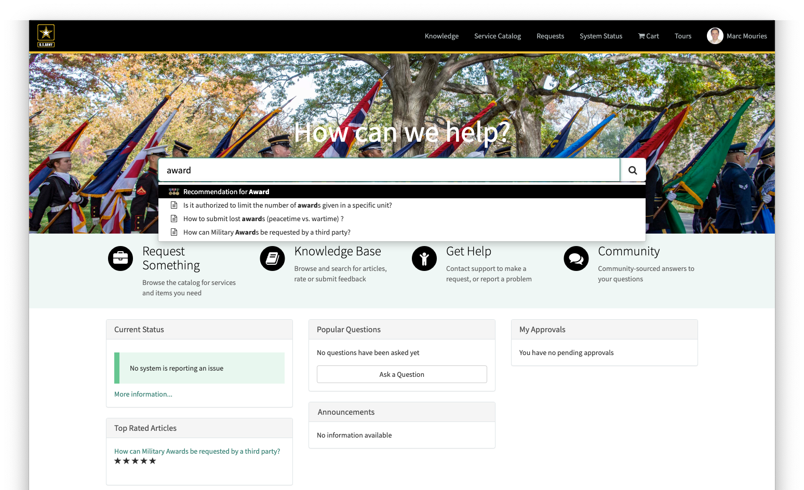
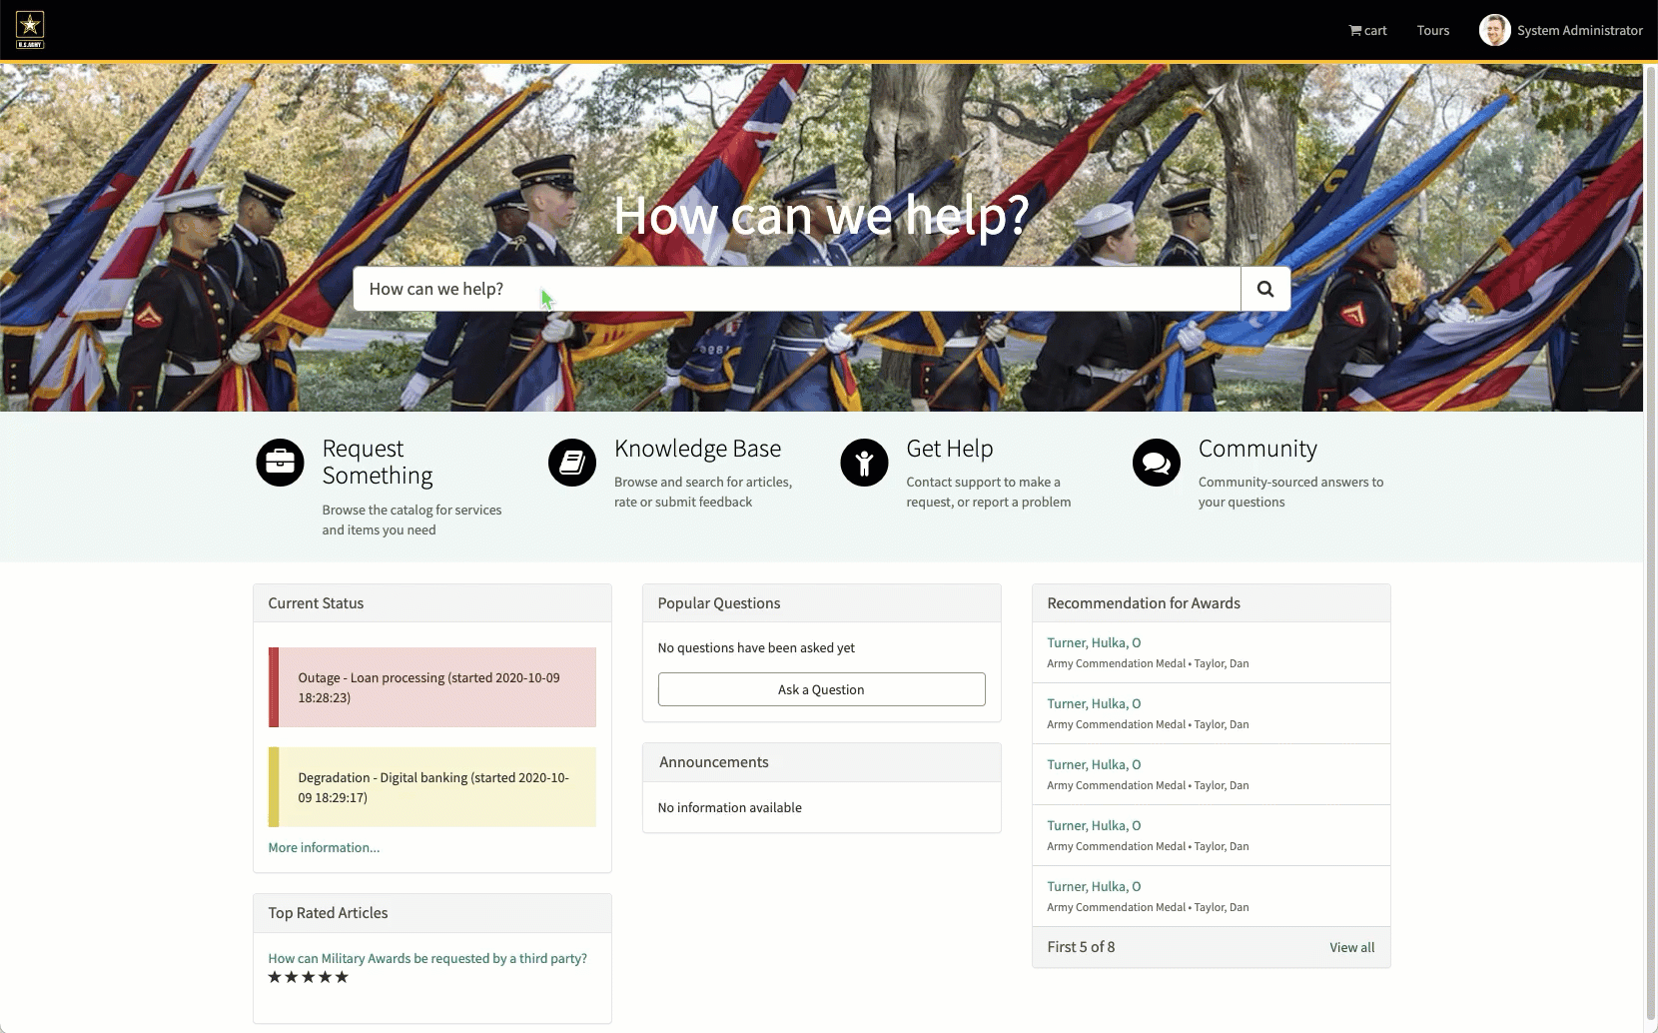
A better way
SOLUTION
PROBLEMS
Service Portal
Modern experience for filling out request forms
What form?
Not using the latest version
AI Search
Easily find the desired forms as well as relevant knowledge
Highly Manual
Time-consuming, prone-to-error tasks
Contextual Awareness
ServiceNow already knows the user details
Time consuming
Form is not intuitive to fill (ex: see page 6 for instructions)
Employee
Obtains the
SF-182 form
Fills the Employee Information in the Form
Fills the Training & Cost Info in the Form
Email the Form to manager
Employees must obtain a copy of the OPM Form SF-182.
Automated
Web
Validates & approves
Second-line
Supervisor
Email the Form to 2nd line manager
Validates & approves
First-line
Supervisor
Automated
Email the Form to Training Officer
Training
Officer
Validates & approves
Email the Form to Authorizing Official
Authorizing
Official
Supervisor puts the name of the authorizing official?
Cost & Training info is manually entered in Cornerstone
Manually request Purchase in ServiceNow
Email approval notice to employee
Validates & approves
Notes:
Nice to have:
Load the data automatically without having to click on demo data.
https://empmmouries1.service-now.com/nomination?id=intake
WARNING: HIGHLY ANIMATED!!!!
CLICK (PROBLEMS GO AWAY)
CLICK (next slide)
(green box appears)
PERSON A: The first thing we’ll automate is the way that the employee finds the form.
PERSON A: We’ll do this by adding a portal where the employee can easily find the form. This will make sure things are consistent and the employee is always filling out the correct version. CLICK (screen goes dark, portal appears)
PERSON A: Here is an example of a digital version of form DOD-638. A Service Portal is the main way that end users interact with request forms in ServiceNow. The Search bar makes it easy to find the desired form and since it’s we already know who the user is they don’t need to provide information about themselves, their job role, location, etc. They can focus on just providing the needed information. The digital form can also interact with the user and change dynamically based on their answers.
CLICK (next slide)

Slide 19
Solution: DoD Portal, Search & Form
Employee
Obtains the
SF-182 form
Fills the Employee Information in the Form
Fills the Training & Cost Info in the Form
Email the Form to manager
Employees must obtain a copy of the OPM Form SF-182.
Automated
Validates & approves
Second-line
Supervisor
Email the Form to 2nd line manager
Validates & approves
First-line
Supervisor
Automated
Email the Form to Training Officer
Training
Officer
Validates & approves
Email the Form to Authorizing Official
Authorizing
Official
Supervisor puts the name of the authorizing official?
Cost & Training info is manually entered in Cornerstone
Manually request Purchase in ServiceNow
Email approval notice to employee
Validates & approves
Notes:
portal zooms in. animation auto plays.
CLICK (next slide)

Slide 20
Solution: DoD Portal, Search & Form
Employee
Obtains the
SF-182 form
Fills the Employee Information in the Form
Fills the Training & Cost Info in the Form
Email the Form to manager
Employees must obtain a copy of the OPM Form SF-182.
Automated
Web
Validates & approves
Second-line
Supervisor
Email the Form to 2nd line manager
Validates & approves
First-line
Supervisor
Automated
Email the Form to Training Officer
Training
Officer
Validates & approves
Email the Form to Authorizing Official
Authorizing
Official
Manually request Purchase in ServiceNow
Email approval notice to employee
Validates & approves
Notes:
portal animates away
CLICK for next slide

Slide 21
Solution:
SOLUTION
SF-182: Future state
Service Portal
Modern experience for filling out request forms
AI Search
Easily find the desired forms as well as relevant knowledge
Easier Communications
Users can chat directly on the ticket
Employee
Obtains the
SF-182 form
Fills the Employee Information in the Form
Fills the Training & Cost Info in the Form
Email the Form to manager
Employees must obtain a copy of the OPM Form SF-182.
Automated
Web
Validates & approves
Second-line
Supervisor
Email the Form to 2nd line manager
Validates & approves
First-line
Supervisor
Add screenshot of ticket questions on ticket form between users.
Automated
Email the Form to Training Officer
Training
Officer
Validates & approves
Email the Form to Authorizing Official
Authorizing
Official
Manually request Purchase in ServiceNow
Email approval notice to employee
Validates & approves
Notes:
With ServiceNow… Employee gets an email with a link to get back to SN instance… and they can interact in a chat interface on the request. This saves back and forth time so no emails are needed.
CLICK (green boxes go away)
CLICK (next slide)

Slide 22
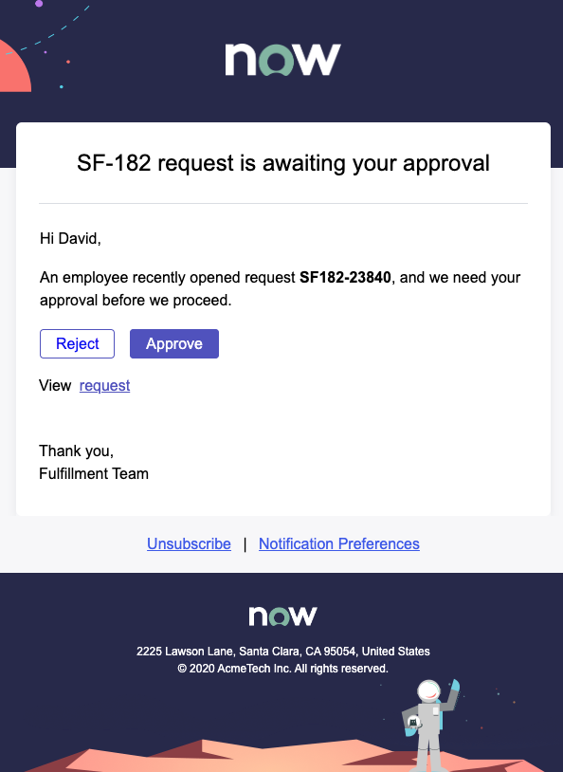
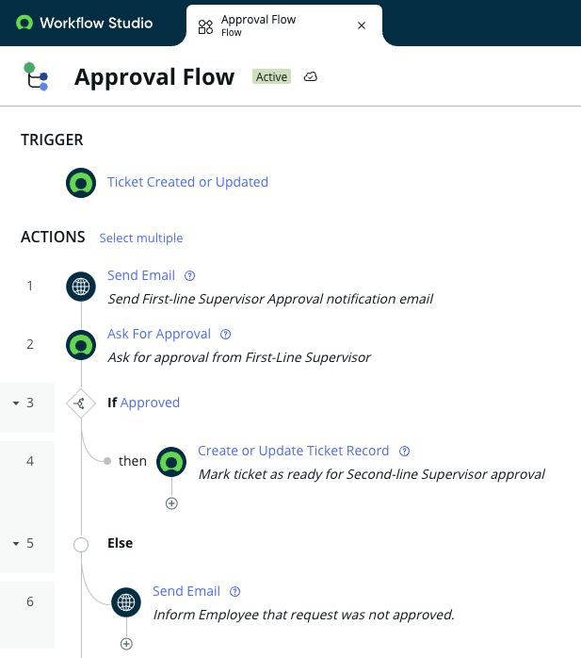
SOLUTION
PROBLEMS
SF-182: Future state
Manual Work
Opening PDF and Emailing
Automated Validations
Approvers only need to validate what they need to validate
Automated Notifications
System Emails the right person at the right time
Lack of Visibility
Where should I check status?
Visual Flows
No-code allows for approval flows to be built without code
Employee
Obtains the
SF-182 form
Fills the Employee Information in the Form
Fills the Training & Cost Info in the Form
Email the Form to manager
Employees must obtain a copy of the OPM Form SF-182.
Automated
Web
Automated
Validates & approves
Second-line
Supervisor
Email the Form to 2nd line manager
Validates & approves
First-line
Supervisor
Automated
Automated
Email the Form to Training Officer
Training
Officer
Validates & approves
Email the Form to Authorizing Official
Authorizing
Official
Automated
Manually request Purchase in ServiceNow
Email approval notice to employee
Validates & approves
Notes:
WARNING: HIGHLY ANIMATED!!!!
CLICK (PROBLEMS GO AWAY)
PAUSE (SOLUTIONS APPEAR)
CLICK (next slide)

Slide 23
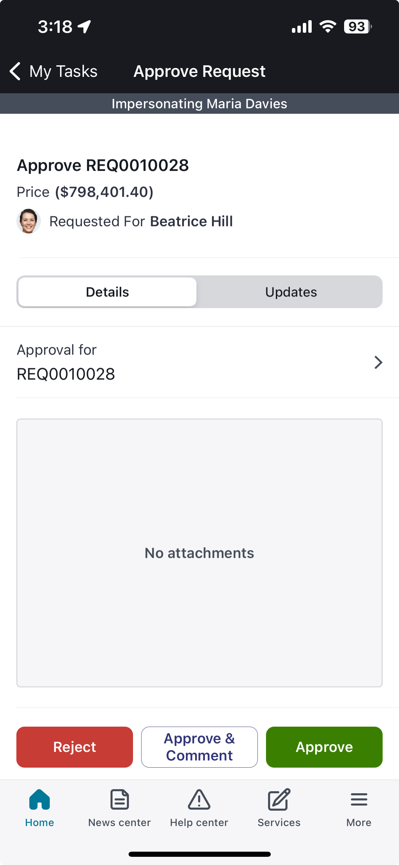
SOLUTION
SF-182: Future state
Automated Notifications
System Emails the right person at the right time
Automated Validations
Approvers only need to validate what they need to validate
Visual Flows
No-code allows for approval flows to be built without code
Employee
Obtains the
SF-182 form
Fills the Employee Information in the Form
Fills the Training & Cost Info in the Form
Email the Form to manager
Employees must obtain a copy of the OPM Form SF-182.
Automated
Web
Automated
Validates & approves
Second-line
Supervisor
Email the Form to 2nd line manager
Validates & approves
First-line
Supervisor
Automated
Automated
Email the Form to Training Officer
Training
Officer
Validates & approves
Email the Form to Authorizing Official
Authorizing
Official
Automated
Manually request Purchase in ServiceNow
Email approval notice to employee
Validates & approves
Notes:
CLICK (next slide)

Slide 24
PROBLEMS
SF-182: Future state
Manual entry
Cost & Training is manually entered into Cornerstone
Employee
Obtains the
SF-182 form
Fills the Employee Information in the Form
Fills the Training & Cost Info in the Form
Email the Form to manager
Employees must obtain a copy of the OPM Form SF-182.
Automated
Web
Automated
Validates & approves
Second-line
Supervisor
Email the Form to 2nd line manager
Validates & approves
First-line
Supervisor
Automated
Plug automation engine here
Especially the Cornerstone spoke
Show the Cornerstone spoke in Flow Designer
Automated
Email the Form to Training Officer
Training
Officer
Validates & approves
Email the Form to Authorizing Official
Authorizing
Official
Automated
Cost & Training info is AUTOMATICALLY entered in Cornerstone
Automated
Manually request Purchase in ServiceNow
Email approval notice to employee
Validates & approves
Notes:
CLICK (next slide)

Slide 25
SF-182: Future state
Employee
Obtains the
SF-182 form
Fills the Employee Information in the Form
Fills the Training & Cost Info in the Form
Email the Form to manager
Employees must obtain a copy of the OPM Form SF-182.
Automated
Web
Automated
Validates & approves
Second-line
Supervisor
Email the Form to 2nd line manager
Validates & approves
First-line
Supervisor
Automated
Automated
Email the Form to Training Officer
Training
Officer
Validates & approves
Email the Form to Authorizing Official
Authorizing
Official
Automated
Cost & Training info is AUTOMATICALLY entered in Cornerstone
Automated
Automated
Manually request Purchase in ServiceNow
Email approval notice to employee
Validates & approves
Notes:
CLICK (next slide)

Slide 26
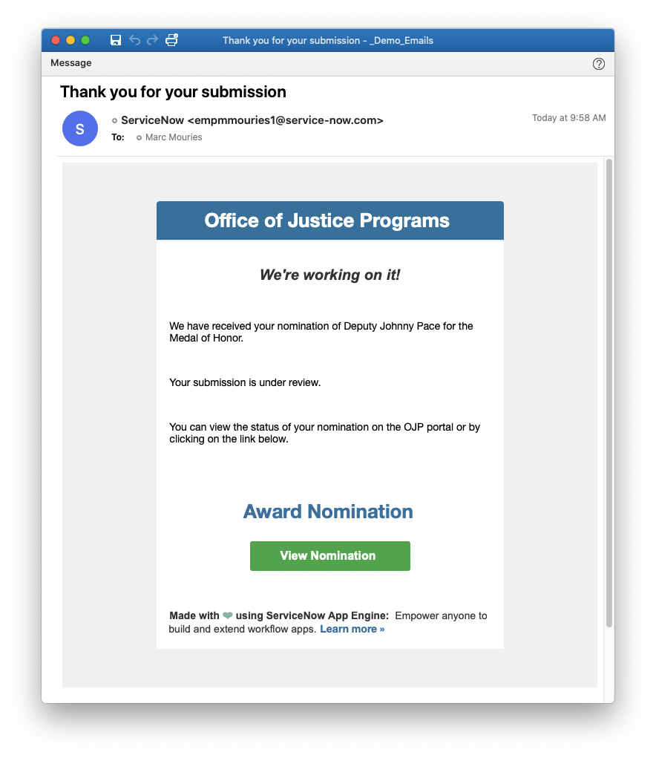
SF-182: Future state
Show a nice email screenshot to the employee
Employee
Obtains the
SF-182 form
Fills the Employee Information in the Form
Fills the Training & Cost Info in the Form
Email the Form to manager
Employees must obtain a copy of the OPM Form SF-182.
Automated
Web
Automated
We have the email screenshot already on slide 23
How might we show one ServiceNow process kicking off another process?
Validates & approves
Second-line
Supervisor
Email the Form to 2nd line manager
Validates & approves
First-line
Supervisor
Automated
Automated
Email the Form to Training Officer
Training
Officer
Validates & approves
Email the Form to Authorizing Official
Authorizing
Official
Automated
Cost & Training info is AUTOMATICALLY entered in Cornerstone
Automated
Automated
Manually request Purchase in ServiceNow
Email approval notice to employee
Validates & approves
Automated
Notes:
CLICK (next slide)

Slide 27
SF-182: Future state
1
Employee
Obtains the
SF-182 form
Fills the Employee Information in the Form
Fills the Training & Cost Info in the Form
Email the Form to manager
Employees must obtain a copy of the OPM Form SF-182.
Automated
Web
Automated
3
5 simple steps
2
Validates & approves
Second-line
Supervisor
Email the Form to 2nd line manager
Validates & approves
First-line
Supervisor
Automated
Automated
4
Everything that can be automated is automated
Email the Form to Training Officer
Training
Officer
Validates & approves
Email the Form to Authorizing Official
Authorizing
Official
Automated
Cost & Training info is AUTOMATICALLY entered in Cornerstone
Automated
5
Automated
Manually request Purchase in ServiceNow
Email approval notice to employee
Validates & approves
Automated
Notes:
numbers appear
5 simple steps appear
CLICK (next slide)

Slide 28
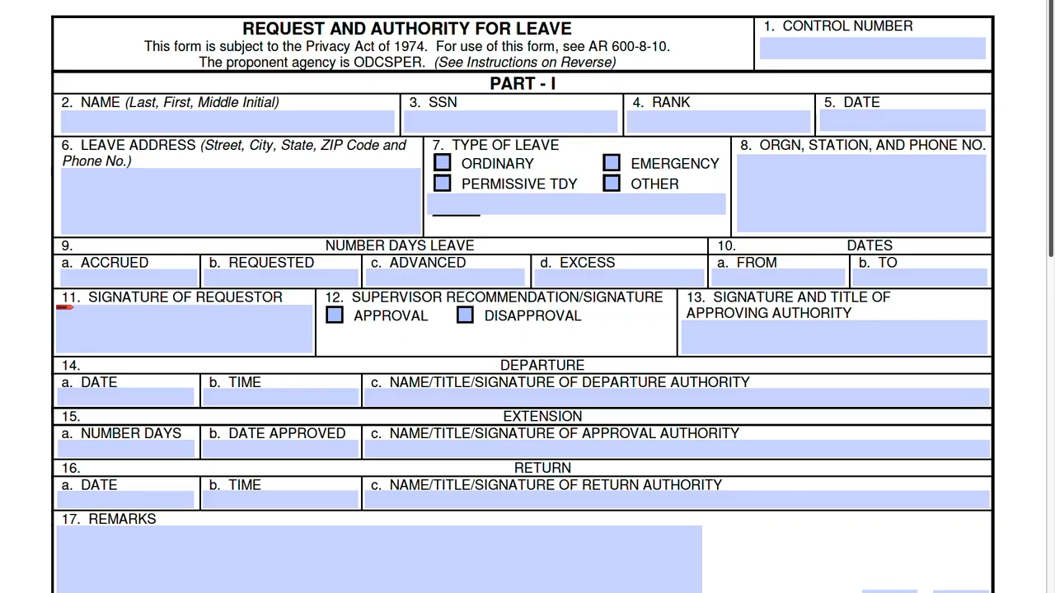
Video Demo PDF Extractor
Notes:
Future state is exciting
But challenges: Many federal forms contain numerous data fields, complicating the digitization process.
Setting up the foundation for these forms requires significant data-modeling efforts.
The focus on data analysis can detract from the creative and innovative aspects of digital transformation.
These challenges create bottlenecks, slowing down the overall digitization effort and impacting the transformation journey.
Introduction of App Engine Studio and its PDF extractor.
using Doc Intel for document intelligence.
Ease of setting up and identifying fields.
Adding fields with choices into the data model.
Generating multiple tables from a single PDF.
Viewing the newly created table and starting digital transformation.
And this is just one example of how agencies can accelerate innovation and value with ServiceNow, the platform for digital business.

Slide 29
SF-182: Transformed
1
Employee
Obtains the
SF-182 form
Fills the Employee Information in the Form
Fills the Training & Cost Info in the Form
Email the Form to manager
Employees must obtain a copy of the OPM Form SF-182.
Automated
Web
Automated
3
2
Validates & approves
Second-line
Supervisor
Email the Form to 2nd line manager
Validates & approves
First-line
Supervisor
Automated
Automated
4
Email the Form to Training Officer
Training
Officer
Validates & approves
Email the Form to Authorizing Official
Authorizing
Official
Automated
Cost & Training info is AUTOMATICALLY entered in Cornerstone
Automated
5
Automated
Manually request Purchase in ServiceNow
Email approval notice to employee
Validates & approves
Automated
Notes:
FINAL SOLUTION READ-ONLY
ONLY SHOW IF NEEDED

Slide 30
Before & After
Current steps
Employee obtains SF-182 form
Fills the Employee Information in the Form
Fills the Training & Cost Info in the Form Information in the Form
Employee emails form to First-line Supervisor
First-line Supervisor validates & approves
Form emailed to Second-line Supervisor
Second-line Supervisor approves
Form emailed to Training Officer
Training Officer approves
Training Officer enters data into Cornerstone
Form emailed to Authorizing Official
Authorizing Official approves
Emails back to Employee
Future state steps
1. Employee fills web form on ServiceNow
2. Data auto-filled, Employee fill the rest & submits
3. Form routed to First-line Supervisor
4. First-line Supervisor reviews & approves
5. Form auto-routed through approval chain
6. Final approval & form generation
Benefits
1. Real-time status updates for Employee

Slide 31
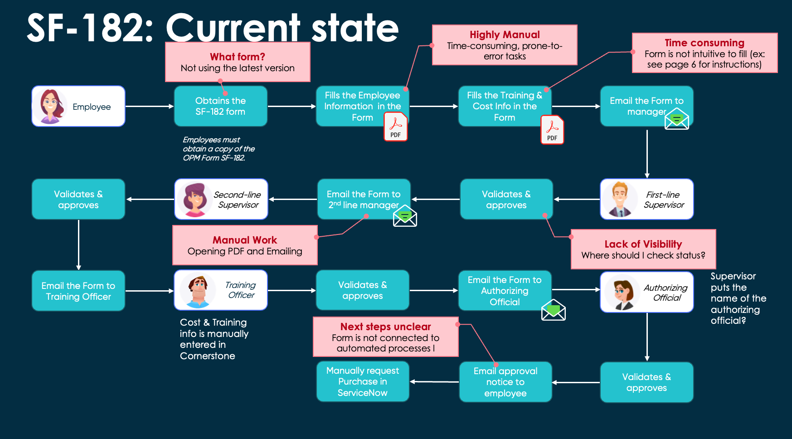
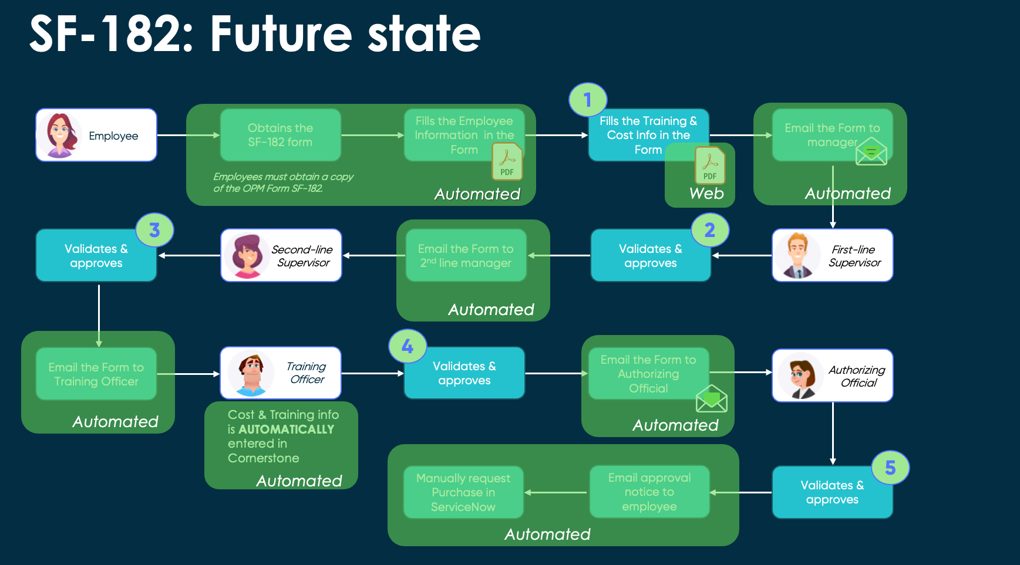
Current state vs Future state
Notes:
CLICK (next slide)

Slide 32
Success Stories
Notes:
CLICK (next slide)

Slide 33

Centralized portal and improved workforce productivity Form 1135 Waiver Process
App Engine Use Case
Public Sector / Healthcare System Operations
LOW-CODE SOLUTION
Streamlined portal for submitting requests, eliminated manual paper forms, and removed a time-consuming step in the process with the ability to track requests nationally and produce aggregate reporting.
OUTCOMES
Eliminated manual paper processes
Centrally managed
web portal
Improved stakeholder experience
Notes:
The Centers for Medicare & Medicaid Services – name and logo not permitted.
https://servicenow.sharepoint.com/:p:/r/sites/WorkflowDesignStudio/Shared%20Documents/App%20Engine%20Team/App%20Engine%20Use%20Case%20of%20the%20Week/2022_0902_CMS_EmergHealthcareWaivers(LowCodeAppDev).pptx?d=w3fef687ee88745d691a651d1d84a0394&csf=1&web=1&e=rUVbHl
About The Customer The Centers for Medicare & Medicaid Services (CMS), is a federal agency within the United States Department of Health and Human Services (HHS) that administers the Medicare program and works in partnership with state governments to administer Medicaid, the Children's Health Insurance Program (CHIP), and health insurance portability standards. The agency has over 6300 Federal Employees with a larger Federal Contracting workforce supporting this agency. The Center for Clinical Standards & Quality (CCSQ), led by the CMS Chief Medical Officer and the CCSQ Leadership Team, is a cadre of professionals with diverse backgrounds in clinical, scientific, public health, legal, IT, project management, academic, and business management fields. They serve CMS, HHS, and the public as a trusted partner with a steadfast focus on improving outcomes, beneficiaries' experience of care, and population health, while also aiming to reduce healthcare costs through improvement. CCSQ’s mission is to improve outcomes, beneficiaries' experience of care, and population health, while also aiming to reduce healthcare costs through improvement.
The Economic Buyer Our target buyer and champion was: Erin Wolf, Deputy Director, Division of User Experience & Support Services (DUXSS)
The Opportunity CMS CCSQ has been a successful ServiceNow customer since 2016 with Technology and Customer Workflows. Public health emergencies, like Hurricane Harvey, the terrorist attacks of 9/11 or any other natural disaster, often present unprecedented challenges and demands on our healthcare systems. The Social Security Act allows CMS to prevent a gap in access to care by issuing waivers (via 1135 Waiver/Flexibility Requests) to traditional requirements which allows states, companies, providers, etc. to remain agile during their emergency response. Prior to January of 2021, waiver applications and inquiries were processed entirely via email. The process created a significant strain on CCSQ’s federal resources, added a large amount of extra work for dependent organizations, and introduced unnecessary confusion during an already confusing time for all stakeholders involved. Furthermore, the waiver process was managed through 5 separate regionally aligned group email mailboxes, making it extraordinarily difficult to obtain a national view and insight into the program at this broad level. Improving the 1135 waiver process for CCSQ was a top priority, but these challenges were common across several publicly facing CCSQ programs. The need to improve stakeholder experience and centrally manage processes was felt throughout the Center and the impact of the improvements would have far reaching implications beyond the 1135 waiver process.
The Solution In the first phase of their digital transformation in 2021, the Center for Medicare & Medicaid Services (CMS) Center for Clinical Standards & Quality (CCSQ) was able to move the critical 1135 Waiver/Flexibility Request and Inquiry Form process from a manual paper process to a digital low-code app with Creator Workflows App Engine. This process is used by state agencies, organizations, and providers to request a waiver/flexibility to continue Medicare and/or Medicaid coverage during emergencies. With the new App Engine based low-code custom app the process was improved in two critical ways. 1) The requesters from state agencies, organizations, or providers were able to eliminate paper forms and submit their requests and/or inquiries through a streamlined web portal. 2) CMS CCSQ eliminated the step of having to process incoming paper forms and was given a much better insight into all of the requests coming in nationally and now had the ability to track them through their internal processes as well as produce aggregate reporting on response and national trends. After the tremendous success of the Form 1135 Waiver Process, CCSQ went on to streamline other essential and critical public processes and procedures. CCSQ digitally transformed its business by launching the CCSQ Support Central portal, the CMS QSEP Help Center portal, the Quality Q&A Tool, and others through proficient utilization of App Engine by their ServiceNow partner, Ventech Solutions. Building on the previous success, in 2022 the Center for Medicare & Medicaid Services (CMS) Center for Clinical Standards & Quality (CCSQ) extended its investment in App Engine by moving to an Unrestricted User model for all 1,695 users of the organization so they could create custom low-code apps that ALL users of CCSQ could leverage.

Slide 34

Re-engineer and automate warehouse compliance examination management
App Engine Use Case
Public Sector / Compliance
LOW-CODE SOLUTION
A custom low-code app that streamlines warehouse licensing, storage contracts, compliance examinations, and financial audits. Adjust oversight, make improvements, view analytics, and stay compliant.
OUTCOMES
Eliminate paperwork and mailing of redundant paper files
Increase speed of compliance exam processing – from 60 days to 30 minutes
Digitally track audit trails of data inputs, actions, and approvals
Notes:
Public Sector / Compliance (Custom)
App for Warehouse Licensing, Storage Contracts, Compliance Examination and Financial Review
Important processes for commodity trade, such as Warehouse Licensing, Storage Contracts, Compliance Examination, and Financial Review processes are managed with antiquated mainframe technology and various spreadsheets and databases that limited data accessibility. This is compounded by a heavy reliance on paper and snail mail, and results in security risks, redundancies and inefficiencies.
Solution:
Re-engineer and automate the Warehouse Compliance Examination Management process with App Engine's low code custom application capabilities. Establish relationships between business entities and warehouses, licenses, storage agreements and implement exam processes of warehouse. Quickly make changes and improvements, view analytics, and complete work at any time of day anywhere with an internet connection.
Benefits:
- Eliminate printed paperwork and snail mailing of redundant paper files - Increase speed of compliance exam processing time - Governance: Electronic audit trails of data inputs, actions and approvals
USDA’s Agricultural Marketing Service, the agency’s Warehouse and Commodity Management Division (WCMD) – name and logo not permitted.
About the Customer As part of the USDA’s Agricultural Marketing Service, the agency’s Warehouse and Commodity Management Division (WCMD) administers a variety of crucial programs integral to the country’s agriculture commodity trade, such as licensing storage facilities (grain elevators, peanut warehouses, etc.); handling direct payment and incentive programs for domestic cotton users; processing cotton, peanut and grain forfeitures; and more. The division includes 85 employees with 40 examiners working directly in the field. Warehouse Services fall into two categories: 1) Federal licenses issued under the United States Warehouse Act (USWA) and 2) Commodity Credit Corporation (CCC) Storage Agreements. Warehouse licensing for agricultural product warehouse operators is required by many States and by some of the CCC storage agreements. This requirement may be met by holding either a State or Federal license. The United States Warehouse Act (USWA) authorizes the Secretary of Agriculture to license warehouse operators who store agricultural products. Warehouse operators that apply must meet the USDA standards established within the USWA and its regulations. Commodity Credit Corporation (CCC) enters into storage agreements with private individuals and companies to allow warehouse operators to store commodities owned by CCC or pledged as security to CCC for marketing assistance loans.
The Economic Buyer
Our target buyers and champions were: Renee Gore, Deputy Administrator OIT (CIO/VP of App Dev),
The Opportunity WCMD, also known as the “FDIC of Corn”, has oversight responsibilities over commodity trade that has a systemic impact of the global financial economy. The Warehouse Licensing, Storage Contracts, Compliance Examination and Financial Review processes were managed with an antiquated IBM COBOL Mainframe and a series of Microsoft Access Databases and Excel Spreadsheets that limited availability & accessibility to the data and processing capabilities. Due to the segmented and siloed nature of the various systems, and inaccessibility of the systems remotely, the inspections team had a heavy reliance on paper and US POSTAL SERVICE MAILING of redundant paper files. This manual paper based process included substantial redundancies, high-security risks and countless inefficiencies across several teams that resulted in almost 60 days to process a Warehouse Compliance Examination.
The Solution
With an ongoing USDA mandate to modernize processes and move to cloud based solutions, the Decision Maker and Executive Sponsor, Renee Gore, Deputy Administrator OIT (CIO/VP of App Dev), made the decision to reengineer and automate the Warehouse Compliance Examination Management process with ServiceNow. USDA, along with their partner Veracity, selected Creator Workflows as the solution to solve their bespoke need. The choice of Creator Workflows gave USDA the ability to build a solution that was an exact match to their need rapidly due to the flexibility of ServiceNow’s App Engine low-code custom application capabilities. USDA implemented a 3 phase approach to modernizing the division’s processes and systems. In Phase 1, WCMD established the relationships between the business entities and its warehouses, licenses, storage agreements and implemented the examinations process of those warehouses. Unlike working with the previous mainframe (which would shut off at 6 p.m.), the new low-code solution immediately allowed the team to quickly make changes and improvements, view analytics, and complete work at any time of day from anywhere with an internet connection —especially important once the pandemic forced the teams to work from home. With a successful Phase 1 completed, the WCMD team was able to move onto Phase 2 and Phase 3 of their program further extending the original solution adding additional capabilities and further streamlining the process. “The benefits are absolutely intangible,” said one WCMD member. The new App Engine-based solution resulted in reducing the Compliance Examination Processing time from 60 days to 30 mins! “If we didn’t have this new ServiceNow system that we have today, we would have really struggled with working from home. You can’t put a dollar amount on that. We can’t even describe how much better it is.” The new solution resulted in $700K annual cost savings in terms of labor, paper, postage and rent savings at the program level and $3M annual cost savings in eliminated hosting and operations fees of the previous mainframe apps.

Slide 35

Automate critical shift turnover processes
App Engine Use Case
Government Transit Agency/ Operations
LOW-CODE SOLUTION
This low-code workstation app allows employees to submit and view shift turnover data digitally, improving operations and visibility. Within 10 days of implementation, the agency saw a 265% increase in electronically recorded data points that
can be used to find key insights.
OUTCOMES
17 Employee Forms Digitized
98+% certification rate for new shift changes
Improve productivity and efficiency
Notes:
Manufacturing / Operations (Custom)
Automated Shift Information Turnover
Shift turnovers are still managed with paper and clipboards in a lot of places. For example, during shift turnover, paper forms are updated by employees at the end of their shift detailing any outages, shortages or anything else of note that the arriving shift should know about. Due to this being manual, it is either not done or incomplete. It also does not provide an opportunity to capture data across all shifts to identify trends and areas for improvement.
Low-code Details: Tablets are at each station with digital forms that make it easy to update at the end of each shift, and easy for the next shift to read.
Automation Engine Value-Ad: Connect with scheduling software to sync data using Integration Hub spokes or RPA bots if no APIs are available
Benefits:
– More confidence when starting shift due to up to date information and ability to easily read what previous shift left – Less downtime and employee accidents due to knowing what to expect during shift (happier employees!) – Ability to identify trends and areas of improvement
– Improved productivity and efficiency!
The Washington Metropolitan Area Transit Authority (WMATA) – name and logo not permitted.
https://servicenow.sharepoint.com/:p:/r/sites/SolutionInnovation/Shared%20Documents/App%20Engine%20Team/App%20Engine%20Use%20Case%20of%20the%20Week/2022_0218_WMATA_LowCodePlatform(ShiftTurnoverApp).pptx?d=wc20cb5a46d444edb949cdce3a55c73dc&csf=1&web=1&e=WSbgPR
About the Customer The Washington Metropolitan Area Transit Authority (WMATA) commonly referred to as METRO, is a tri-jurisdictional government agency that operates transit service in the Washington metropolitan area. WMATA was created by the United States Congress as an interstate compact between the Washington D.C., the State of Maryland, and the Commonwealth of Virginia. Metrorail serves 91 stations and has 117 miles of track. Metrobus serves the nation's capital 24 hours a day, seven days a week with 1,500 buses. Metrorail and Metrobus serve a population of approximately 4 million within a 1,500-square mile jurisdiction. Metro began its paratransit service, MetroAccess, in 1994 and it provides about 2.3 million trips per year. Operating revenues were $900 million in 2020.
The Economic Buyer
Our target buyer and champion was: Ed Donaldson, Director of the Rail Operations Command (Line of Business),
The Opportunity
WMATA has been a ServiceNow customer since 2017, but until recently they have not deeply explored ServiceNow’s capabilities beyond Technology Workflows (ITSM, SPM, ITAM). Building on the success they have had with ServiceNow, the account team starting building awareness in helping WMATA understand ServiceNow’s low-code App Engine capabilities to solve business problems where unstructured or manual work exists. It was discovered that a significant stakeholder objective existed in how the Metro shares critical employee work information across multiple shifts where there are 1,000s of technicians, operators, and controllers who need to communicate. Metro train operations are run by core teams in their Rail Operations Command Center (ROCC). This unit oversees the safety of trains and lines they run on. As Metro employees transition teams from one work shift to another, there was an inefficient and time intensive manual process of filling out over 17 different paper forms and physically exchanging the forms in order to exchange information with the incoming teams for the next shift. This process was rife with human error with incomplete or missing information. This process did not allow for any insight into data to correlate trends or common issues encountered between shifts to take proactive actions or develop new services. WMATA had no central platform for their teams and leaders to collaborate on, and they relied entirely on exchanging manual papers forms. In essence, there was no electronic record of shift turnovers to audit. Our decision maker and economic buyer, Ed Donaldson, Director of the Rail Operations Command (Line of Business), was seeking a flexible low-code application development platform to provide a central platform as the single source of truth for all shift turnovers.
The Solution
WMATA Metro decided to leverage ServiceNow Partner Ignite and licensed Creator Workflows low-code App Engine to design and develop a custom Shift Turnover Application for the Rail Operations Command Center. The Shift Turnover App provides the ROCC Staff with a professional and simple experience to effectively share relevant information easily across shifts electronically. This now makes capturing this information and sharing it a good use of staff time. The new low-code solution is a centralized platform built to enable better communication and improve access to information for employees. The custom application has led to a complete digitization of the entire shift turnover process at Metro and has allowed WMATA to retire a large number of paper forms, and dramatically improve employee’s ability to see, and act on service data. All shift turnovers are now digitally recorded and signed by staff that has led to improved data analytics and reporting. This new low-code solution has improved common operating pictures at Metro and broken down silos that existed with ROCC. Using ServiceNow’s App Engine, Ignite was able to design, test and deploy this new application into production in less than 60 days. After going live on December 1, 2021, in the first 10 days WMATA saw a 98+% certification rate in the effective use of the new shift change processes, and a 265% increase in electronically recorded events/data points. 40 items flagged to the control center command average per 10 days. 823 controlled shift turnovers are being recorded and certified every 10 days. 185 Department Lead shift turnovers are recorded and certified every 10 days. WMATA purchased Creator Workflows Platform Foundations in order to procure additional non-prod instances in their development and testing environment. ROCC now has plans to leverage Creator Workflows App Engine and Automation Engine to automate additional manual business process by rapidly building custom low code applications as well integrate with other systems of record including IBM Maximo and Everbridge.

Slide 36

Now Assist for Everyone
36

Slide 37

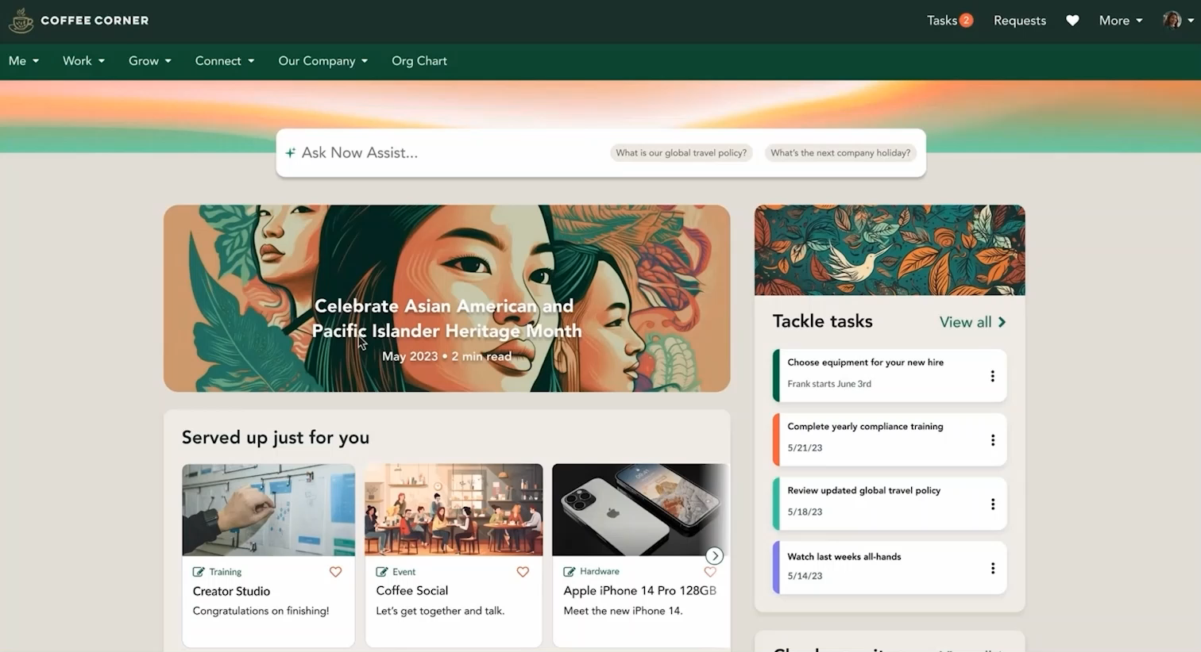
Assisted no-code app creation
Future
Assisted no-code app creation
No-code employee
From text to app
Integrates with Creator Studio
Web and mobile-friendly
Notes:
ONE MORE THING…

Slide 38
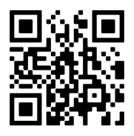
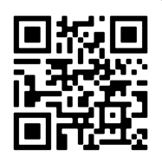
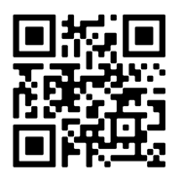
The future of app dev is AI-powered
Make QR code for Fed Forum
Sign up for an innovation workshop
Start building
Get Certified
with a personal developer instance
as a ServiceNow Developer

Slide 39
Questions?

Slide 40


Thank you

